Slide 1
Chino Valley U.S.D.
Hidden Trails E.S.
Mandarin Immersion Info for Kinder Class
Mrs. Sura, 张老师, 冯老师
2023年5月26日

Slide 2
欢迎参加中英双语沉浸式课程介绍会

Slide 3
Agenda
About Chino Valley USD Mandarin Immersion
Sample Kinder Mandarin Immersion Schedule
Instructional Resources
Examples of Kinder Classroom Learning Activities
Example of K-6th Language and Literacy Continuum
Examples of Bilingual-Biliterate Integrated Units
Sample Assessments
Related Dual Language Immersion Research
Suggested Home Learning Support Activities

Slide 4
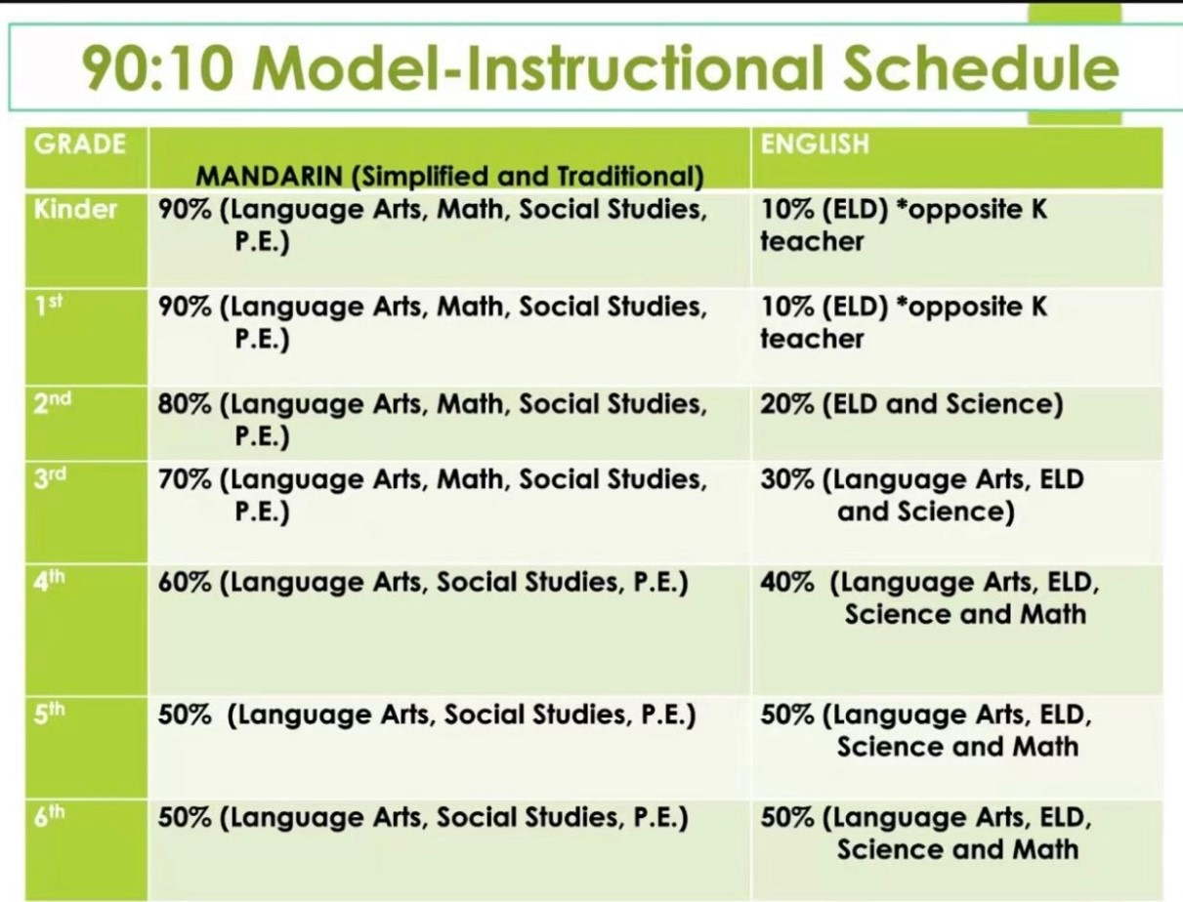
About Chino Valley USD Dual Language Immersion
90-10 Mandarin Immersion Model
Subjects taught in target language - Chinese
Social Study
Science
Math
Chinese Language art
Student-centered classroom
Rich language and literacy input
Whole Group V.S. Small Group Instruction
Project Based Learning
Assessments for both Chinese and English（ESA, I-ready, FastBridge, etc）

Slide 5
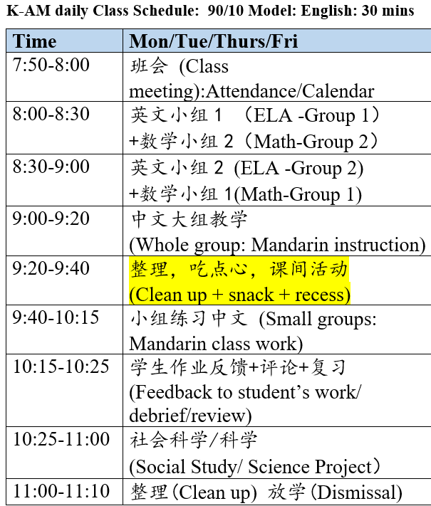
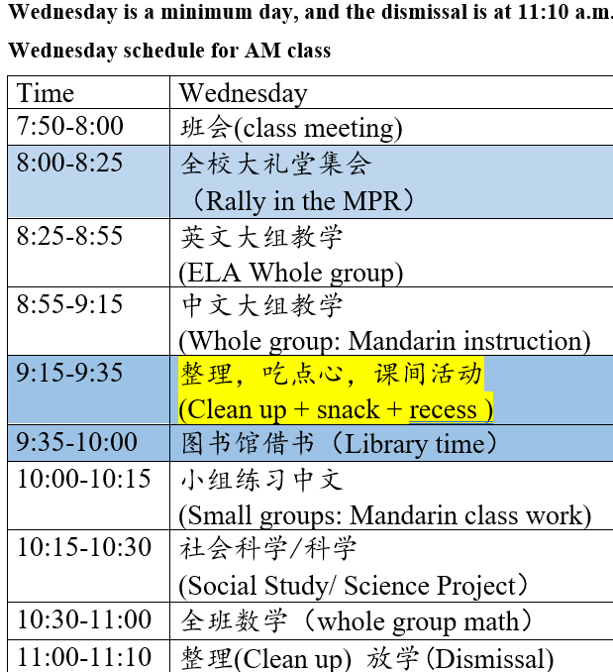
AM Kinder Immersion Schedule
K-AM daily Class Schedule: 90/10 Model: English: 30 mins

Slide 6
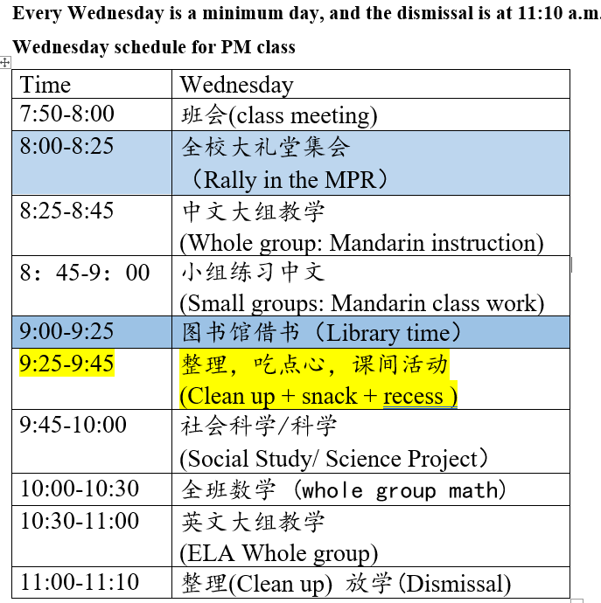
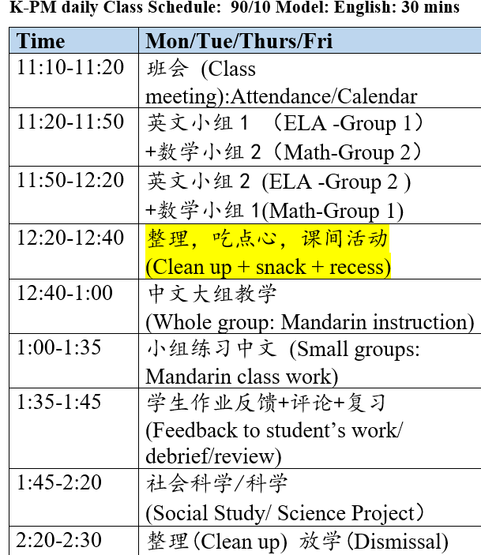
PM Kinder Immersion Schedule

Slide 7
Visual Daily Schedule
班会/全班中文
Class meeting / whole class Mandarin
课间活动
recess
故事时间
Story time
数学 Math
中文小组
Small group Mandarin instruction
英文 English
科学 science
放学 dismissal

Slide 8
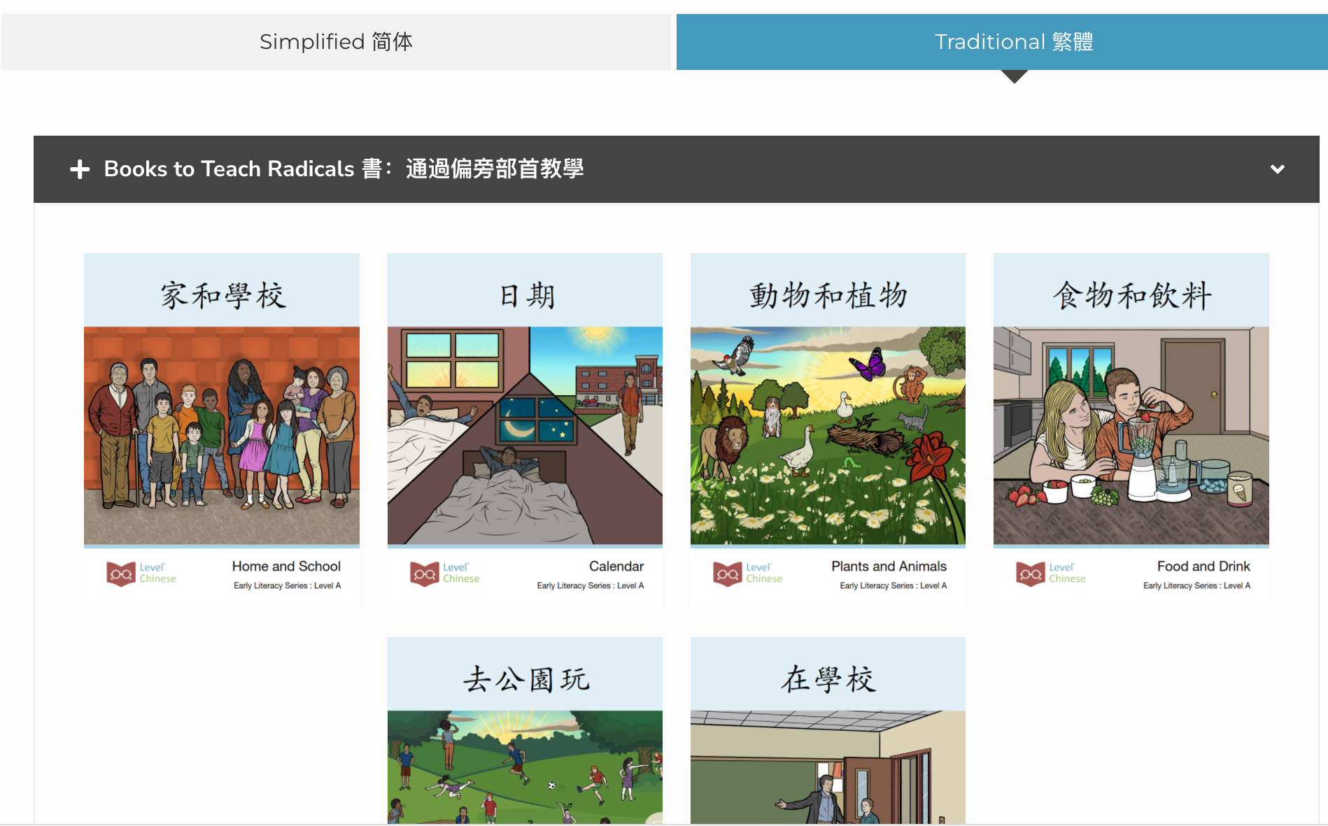
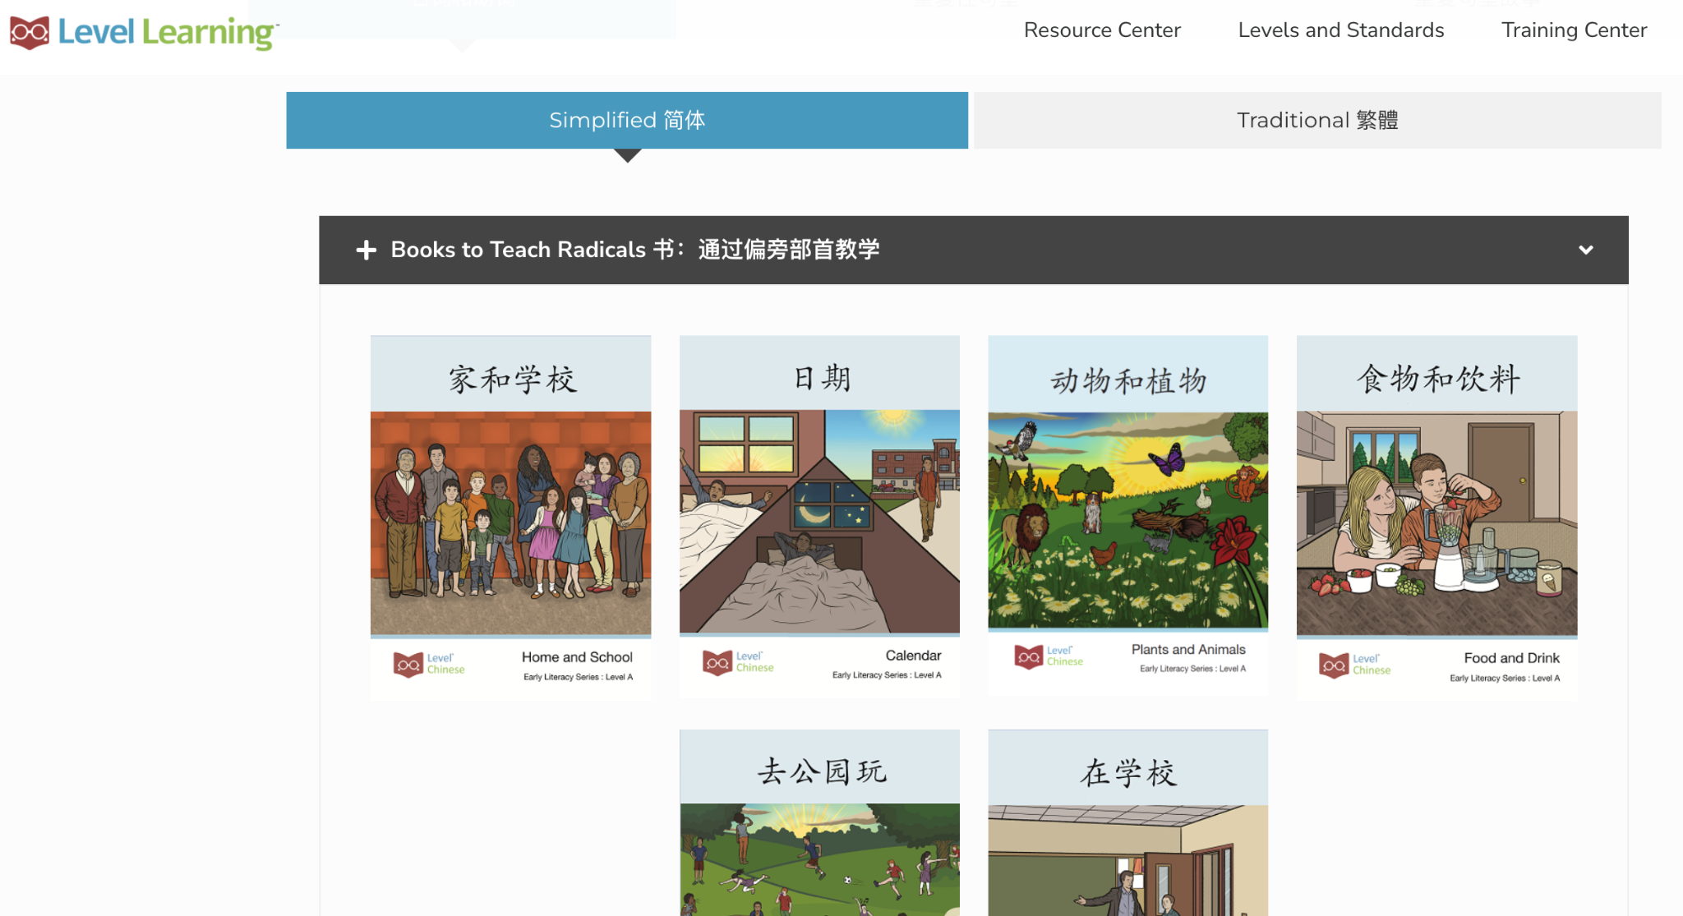
Instructional Resources
Level Learning Early Literacy Books to Teach Radicals (部首书）
Simplified Chinese
Early Literacy Books
简体书
Traditional Chinese
Early Literacy Books
繁體書

Slide 9
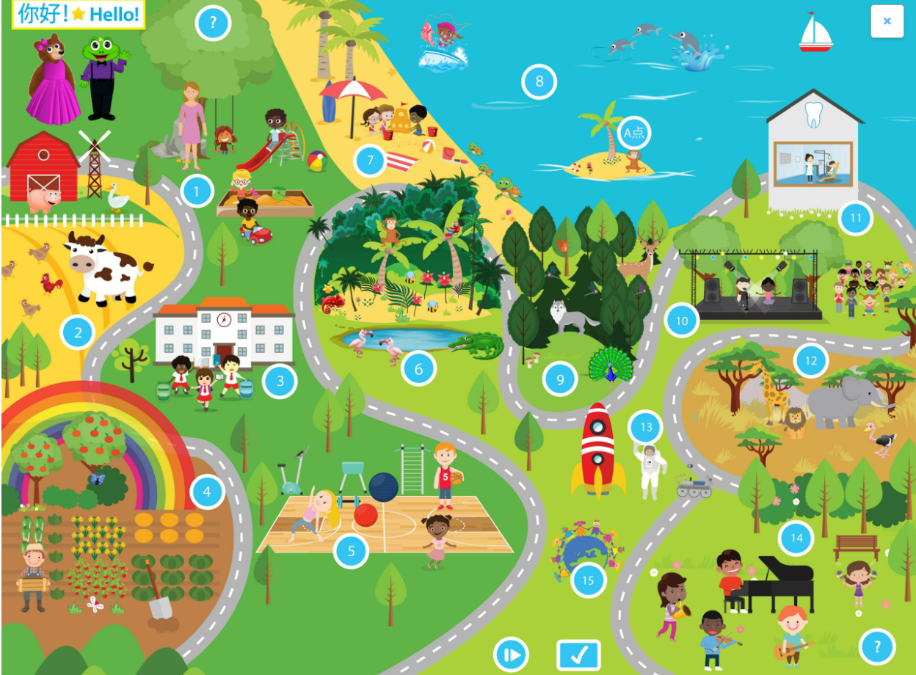
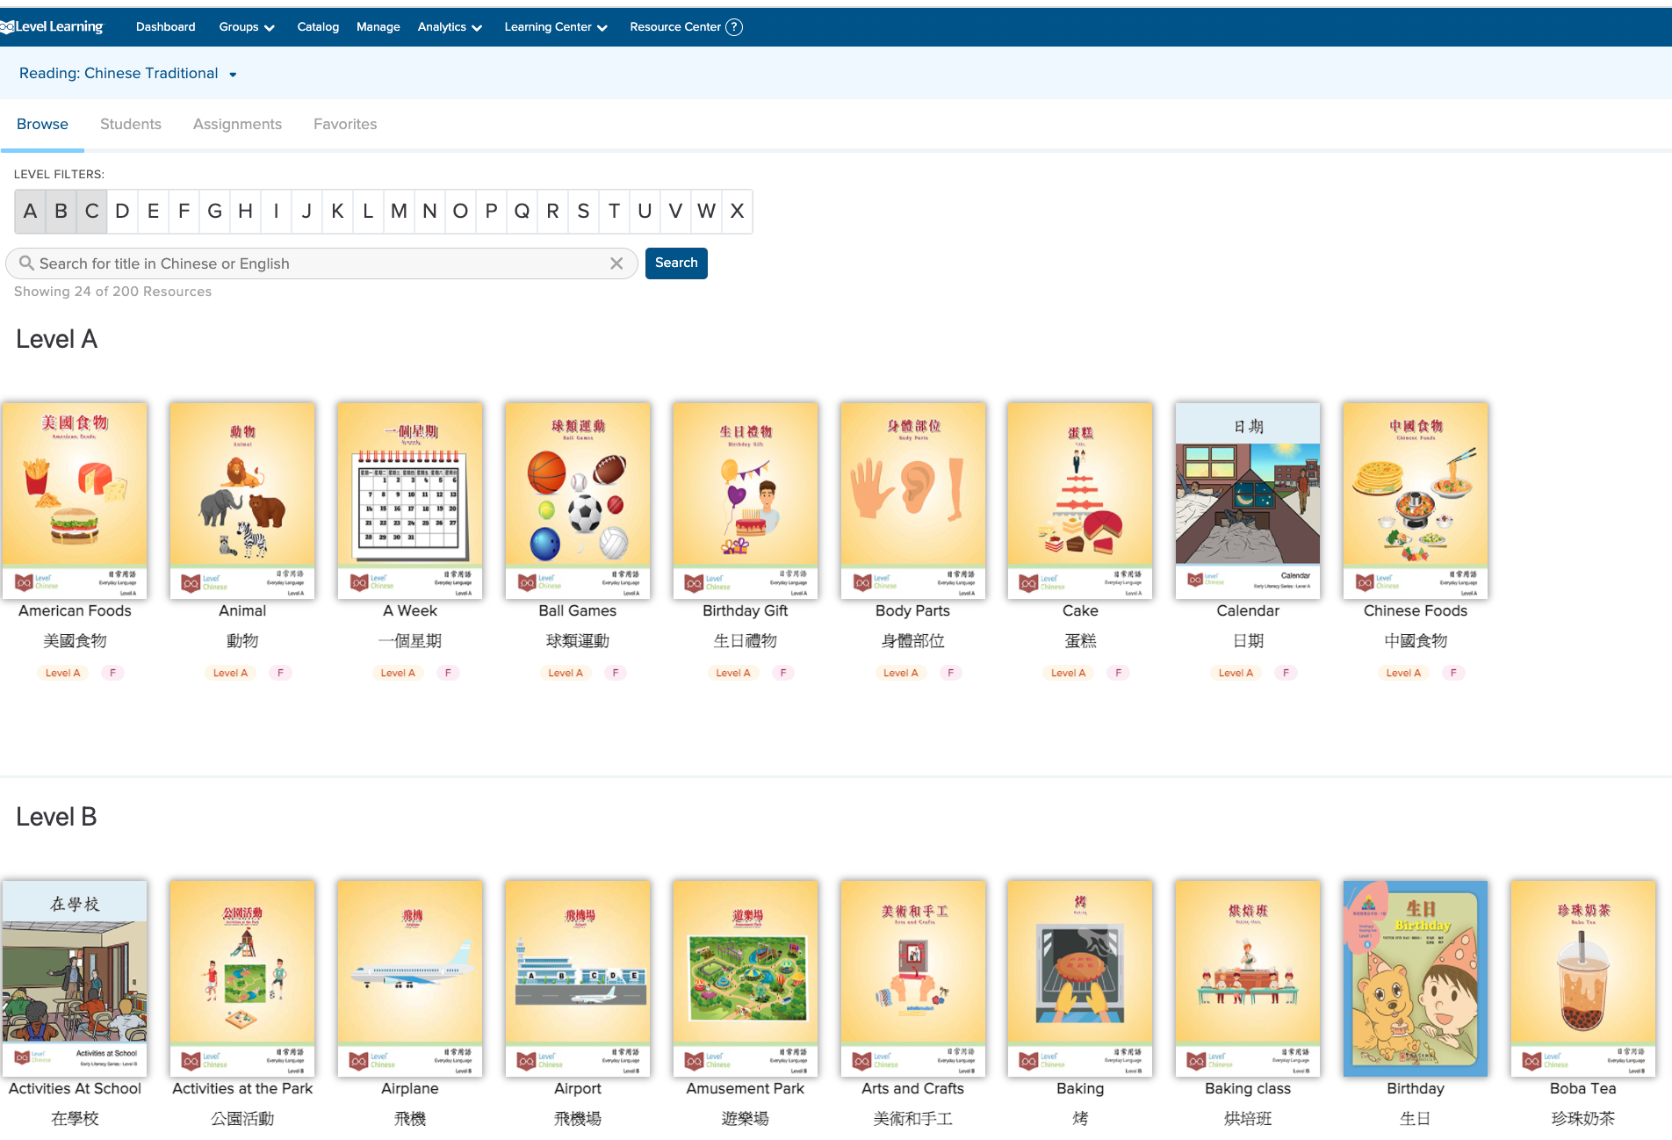
Instructional Resources
Little sponges
Online Level Learning Book Library
Children Books from China Sprout

Slide 10
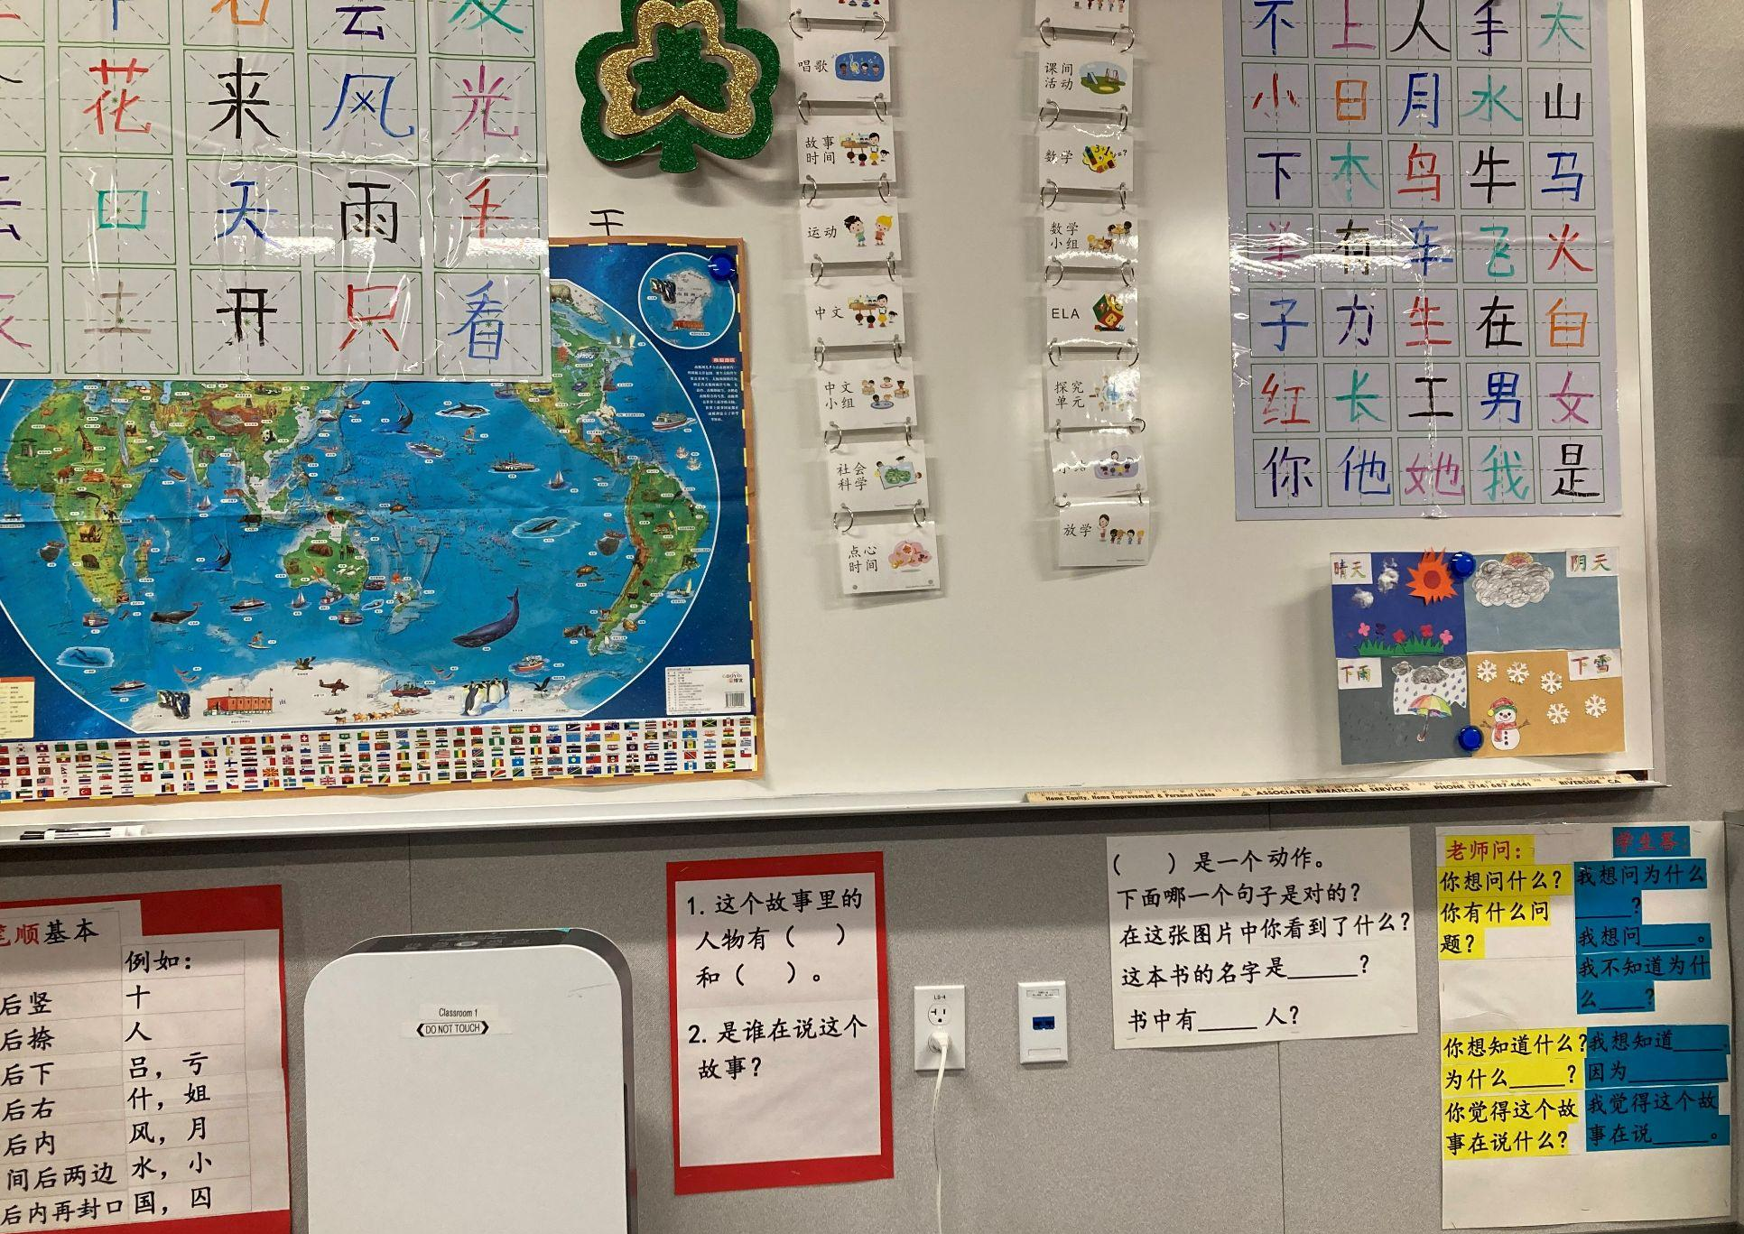
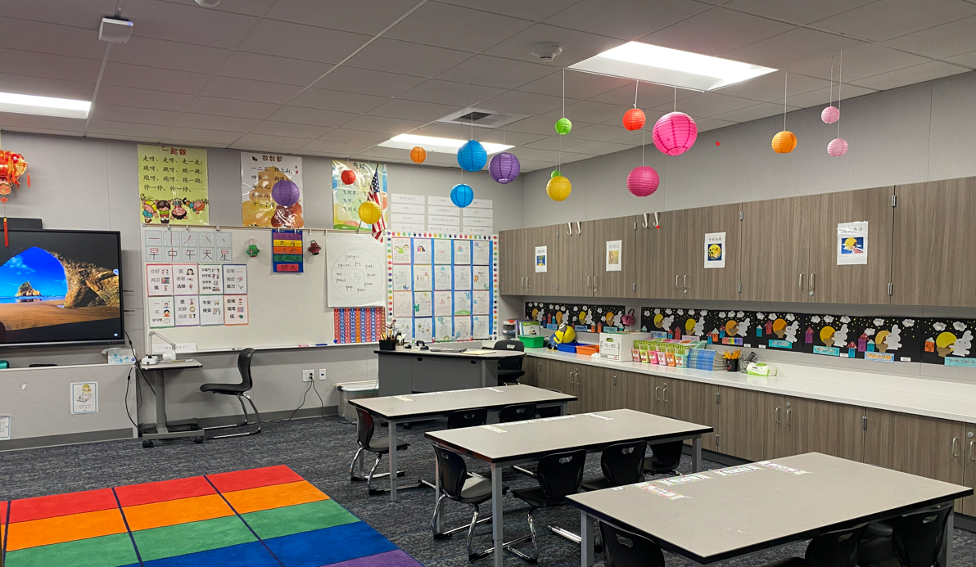
Immersion Learning Space
Bilingual and Biliteracy Bridge 連接中英文

Slide 11
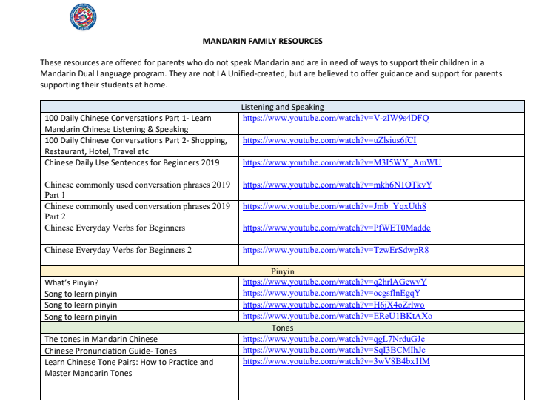
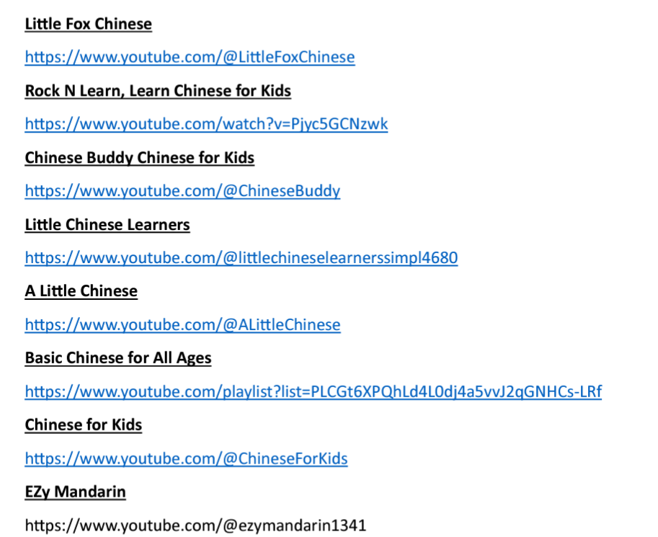
Summer resources for family learning
https://drive.google.com/drive/my-drive
https://www.chino.k12.ca.us/Domain/9537

Slide 12
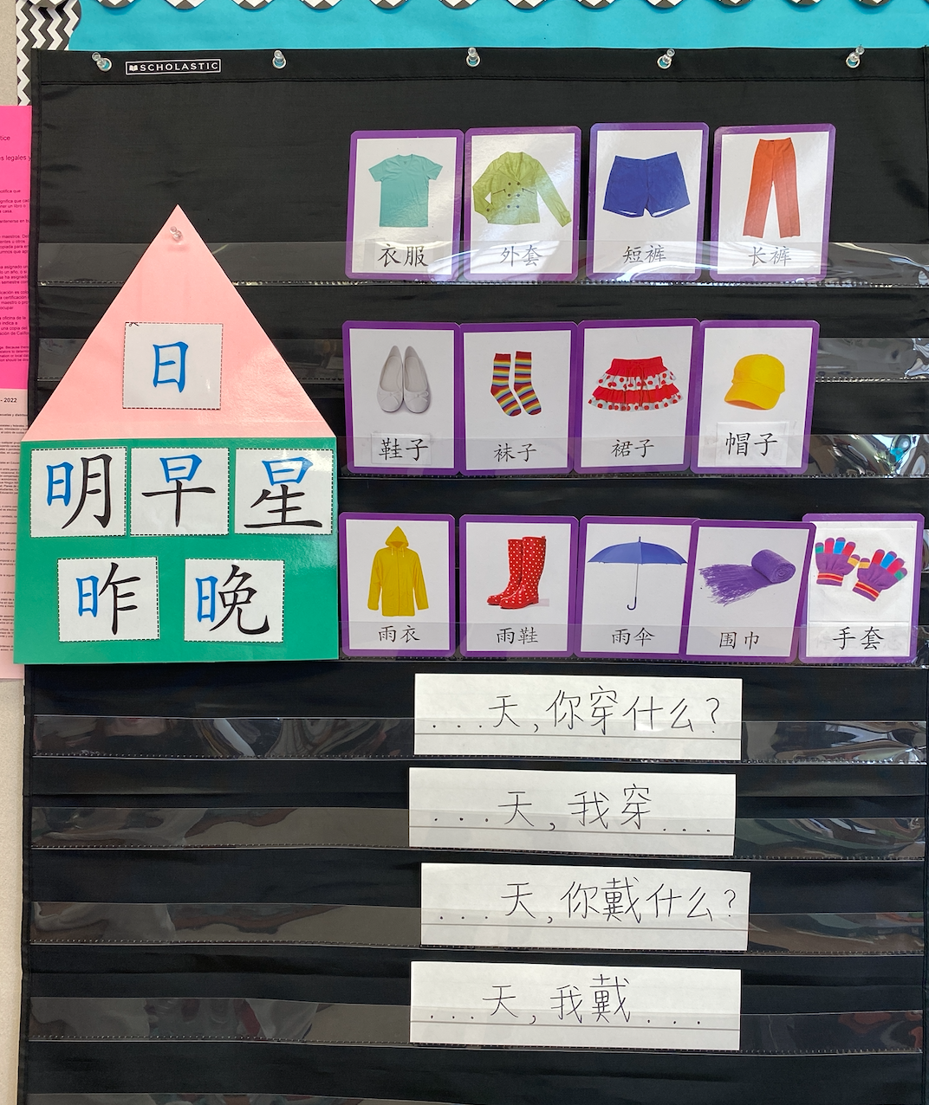
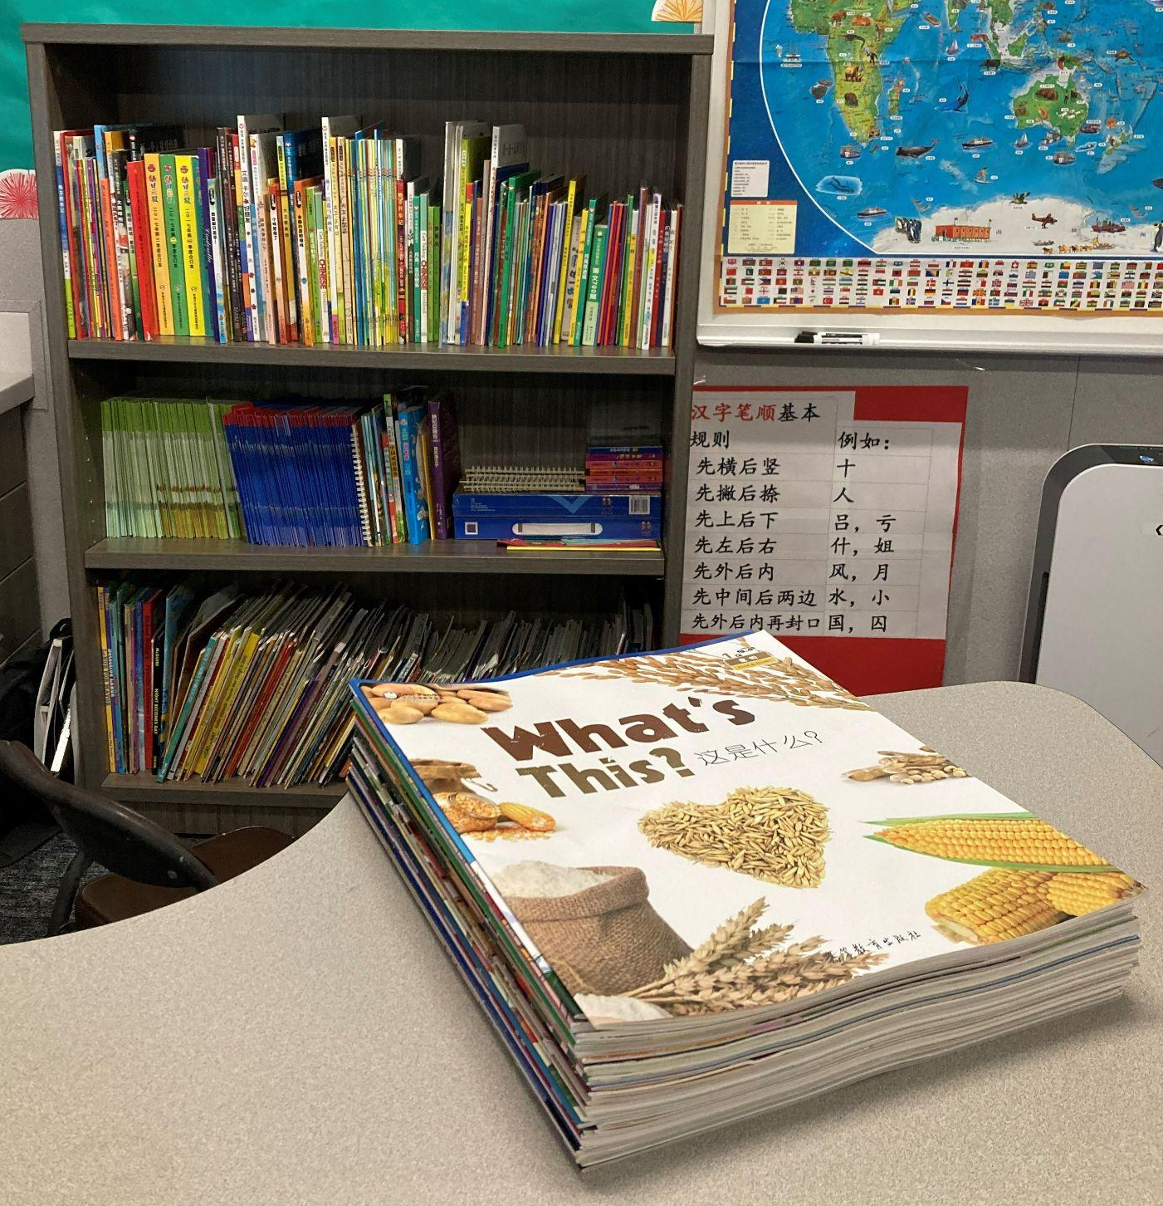
Immersion Learning Space
Radical House
Sentences Structures for Oral Practice
Mandarin Chinese Classroom Library

Slide 13
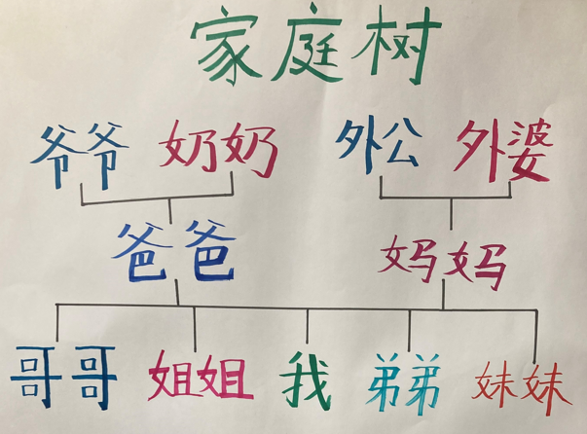
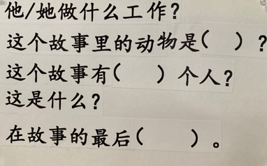
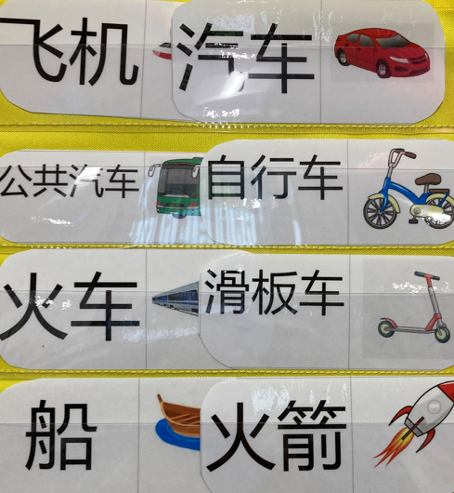
Immersion Learning Space

Slide 14
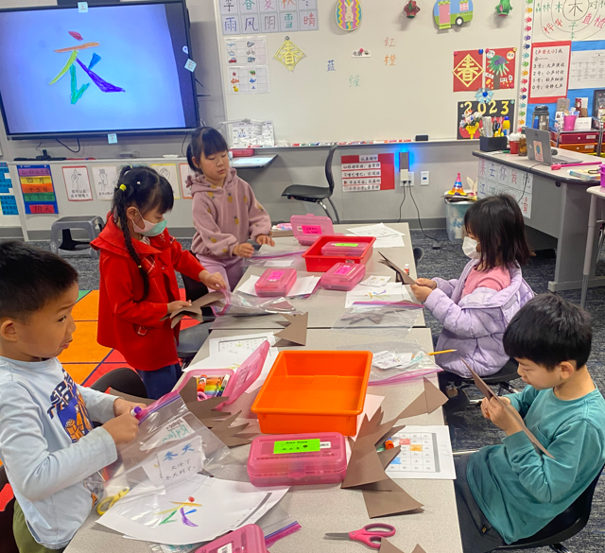
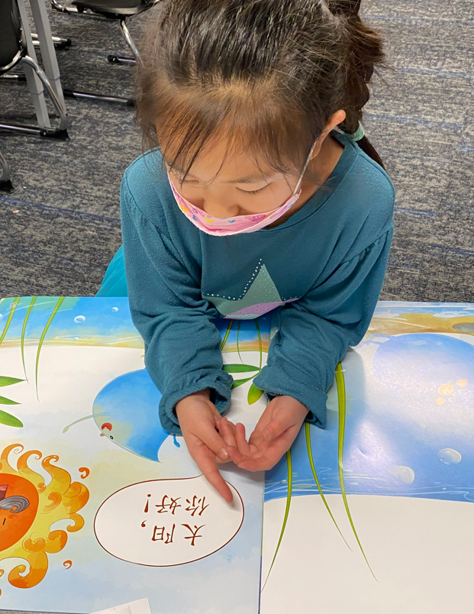
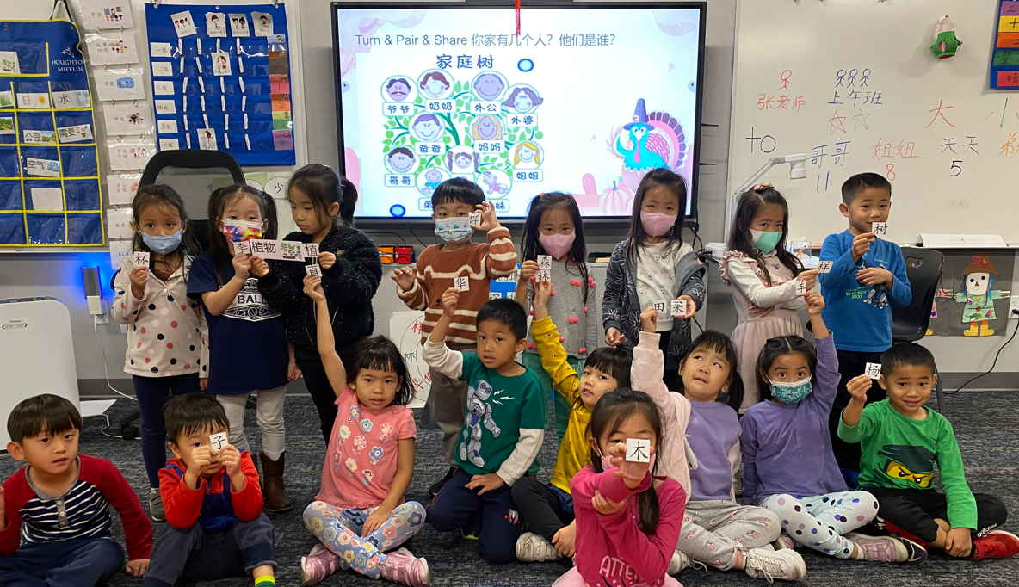
Immersion Learning Activities
Chinese project

Slide 15
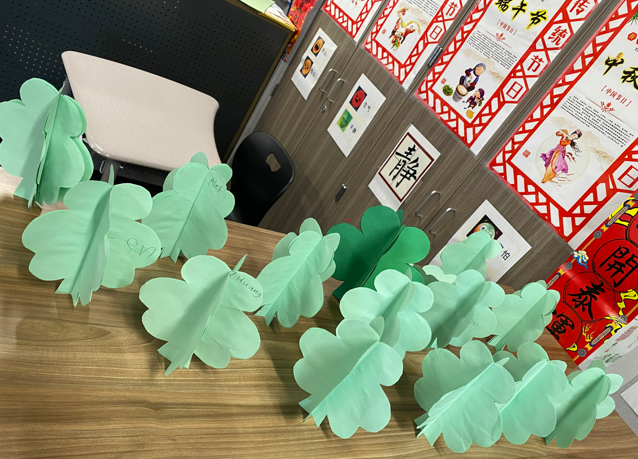
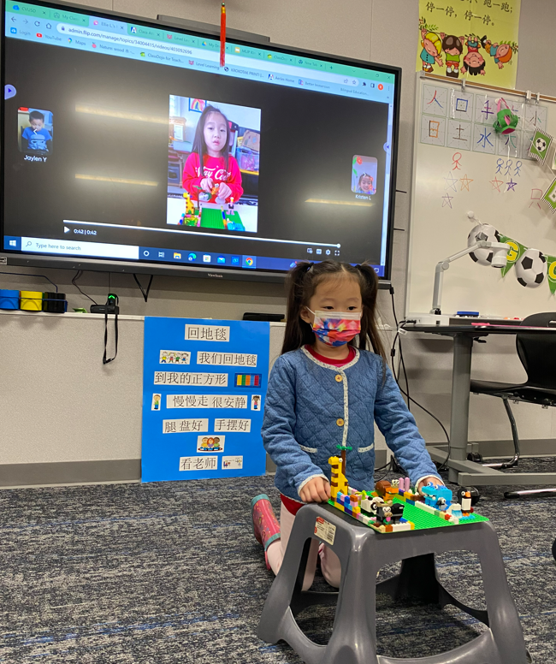
Crafts & Projects

Slide 16
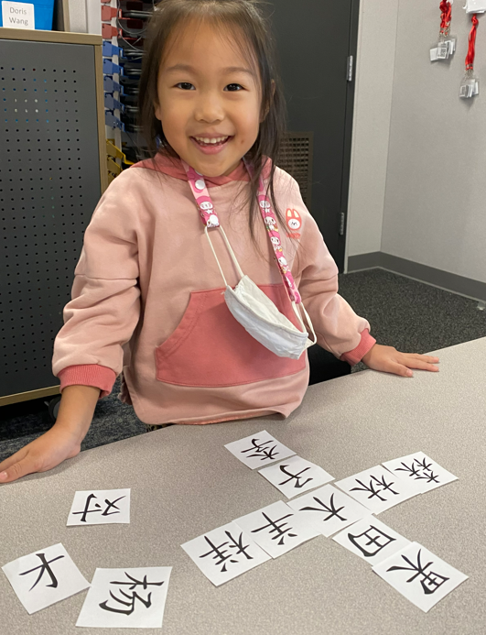
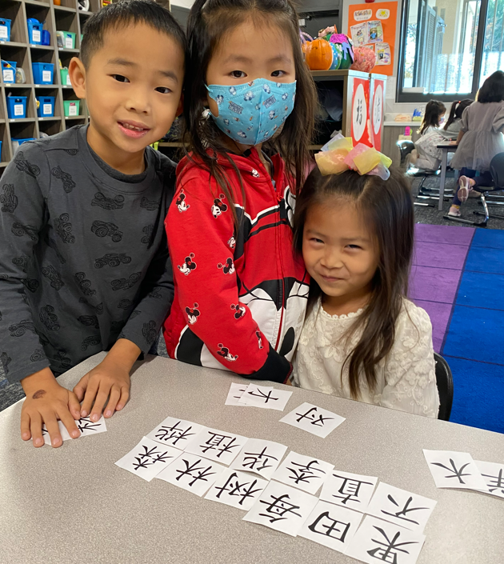
Radical stories

Slide 17
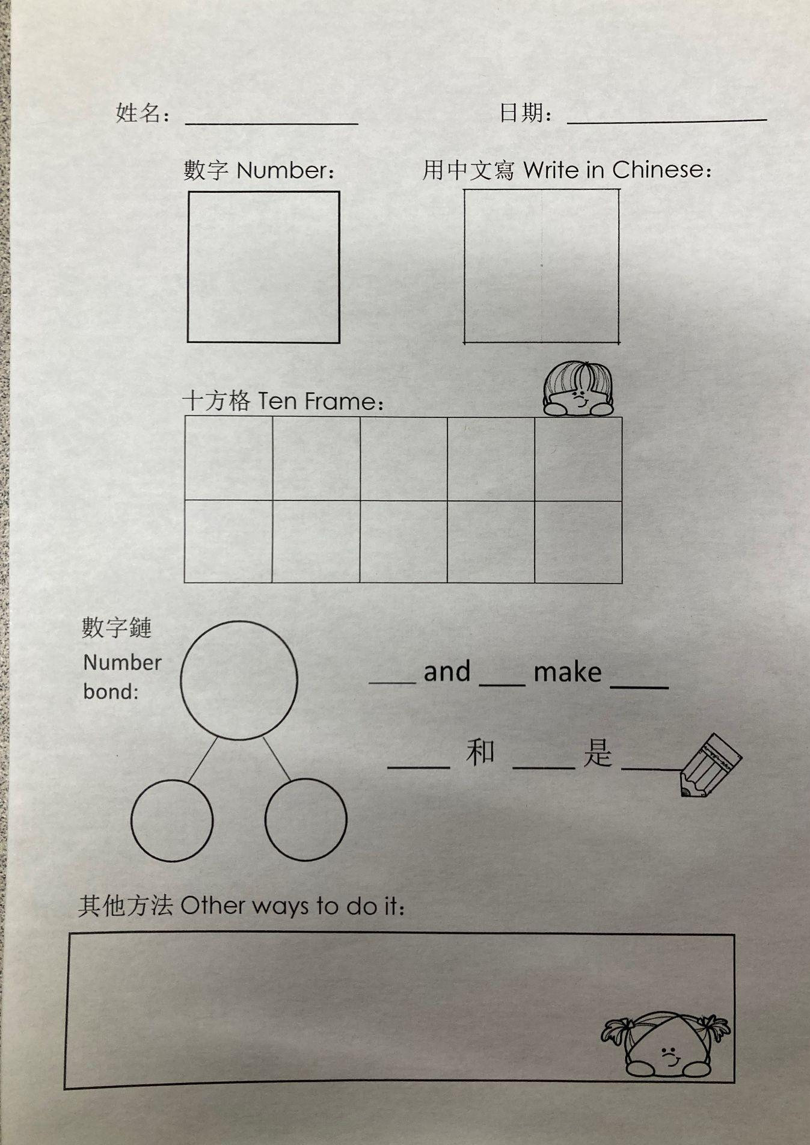
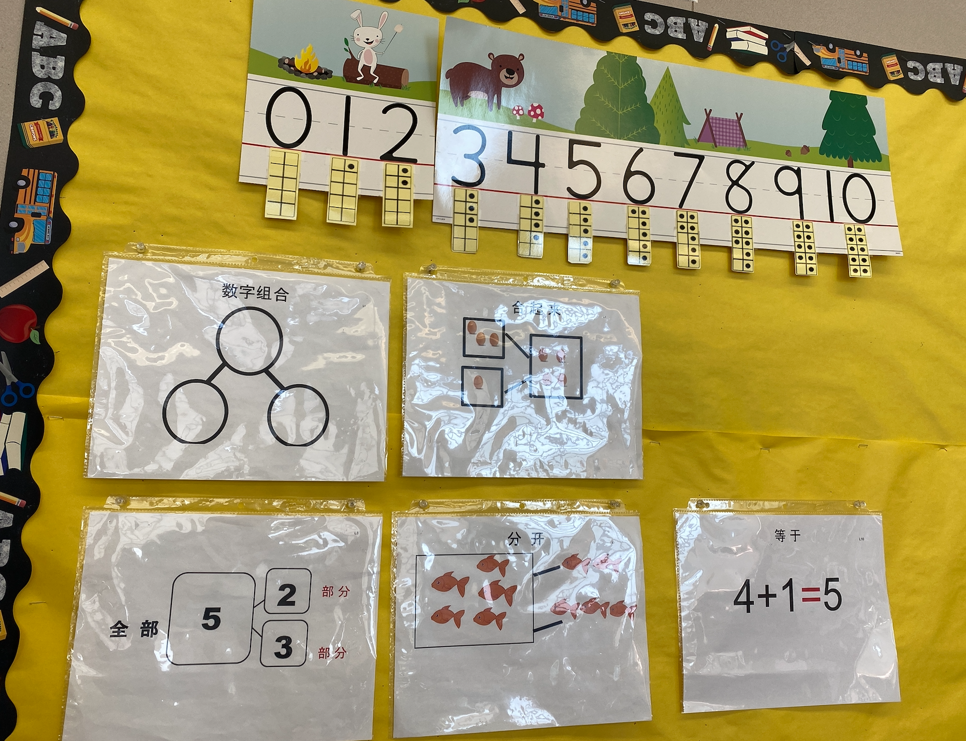
Number Talk
Math Strategies Wall

Slide 18
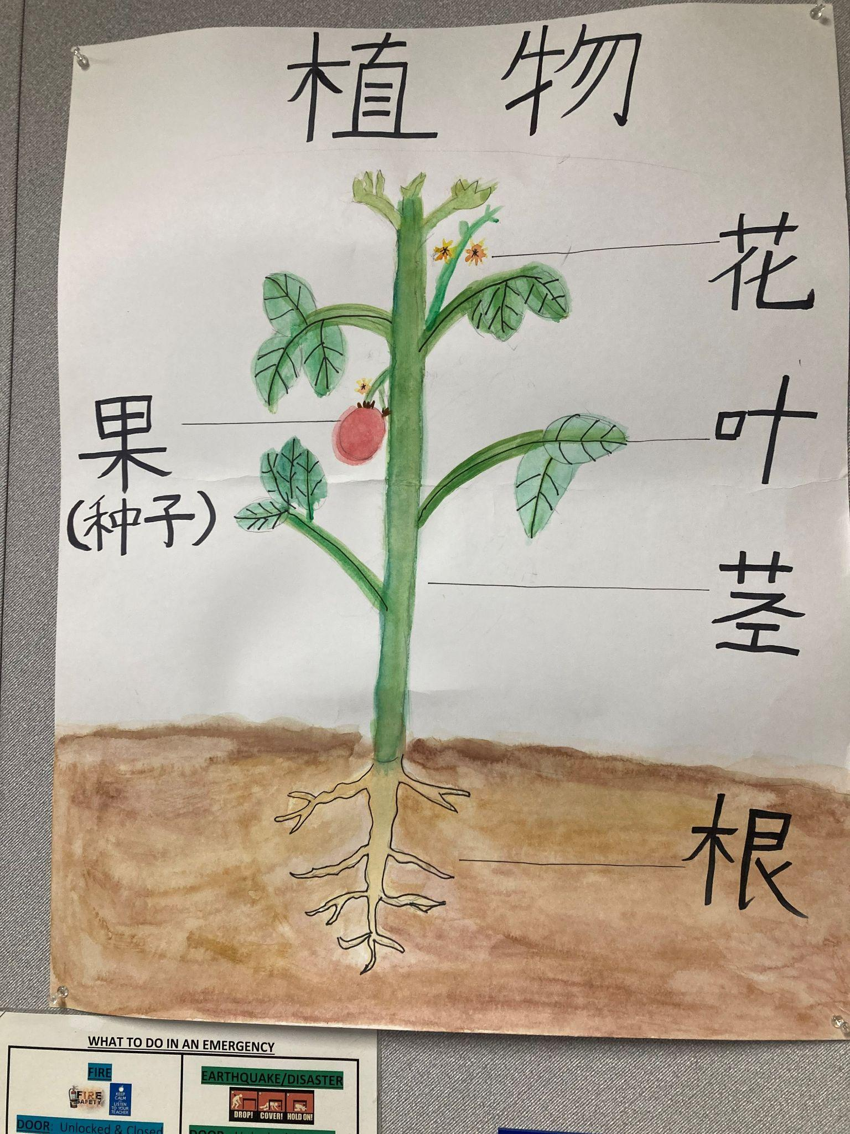
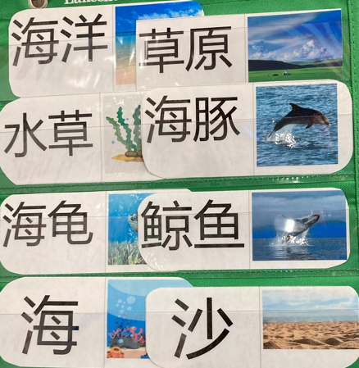
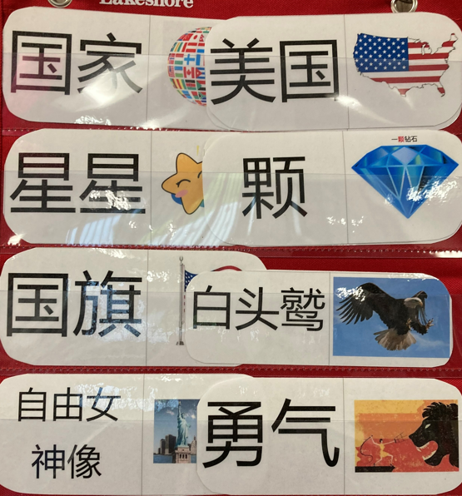
Science and social science

Slide 19
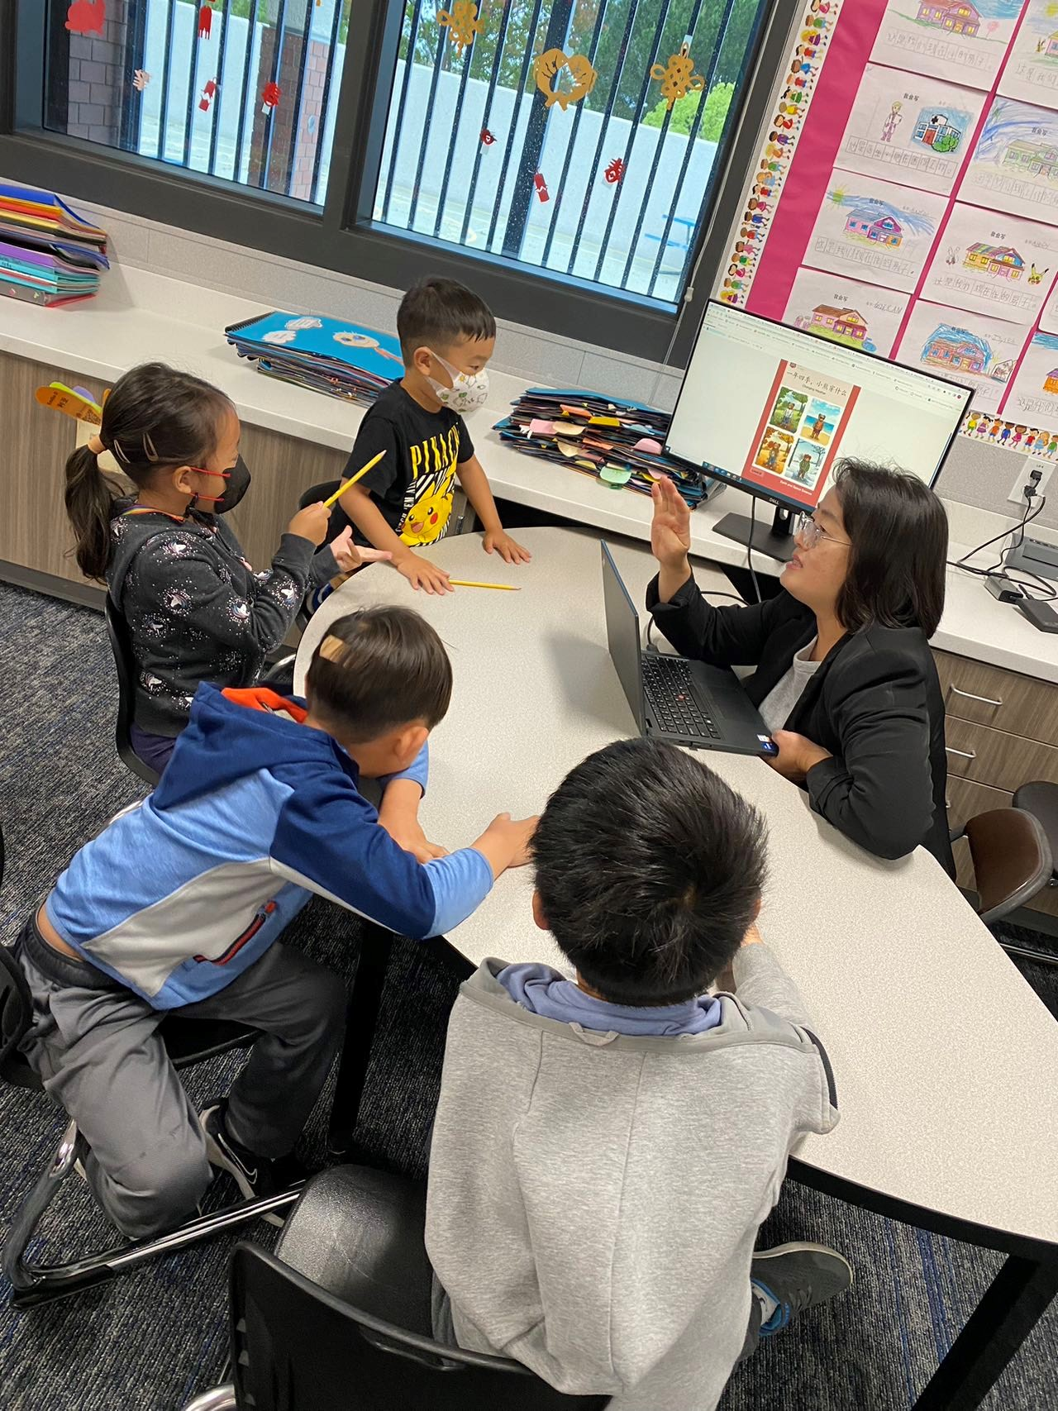
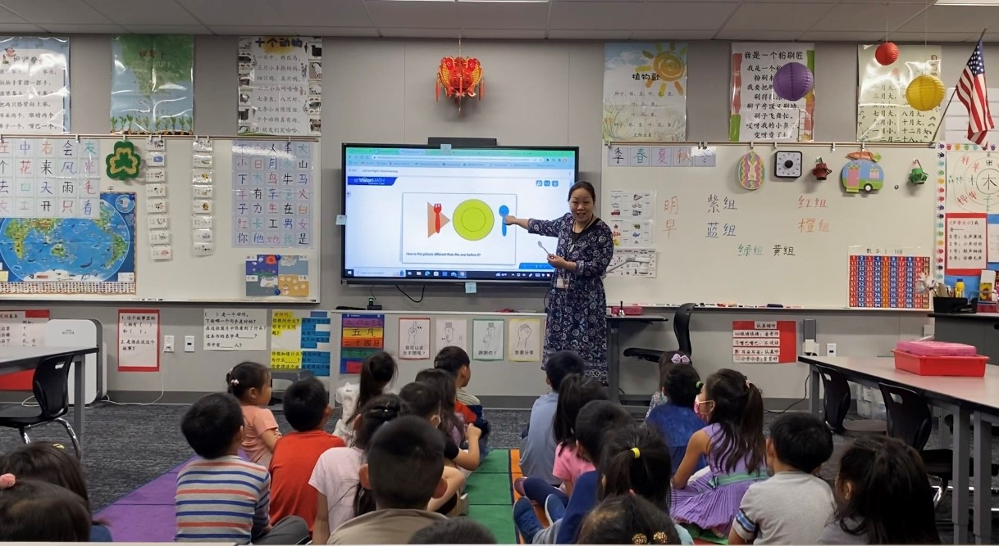
Whole Group V.S. Small Group Instruction

Slide 20
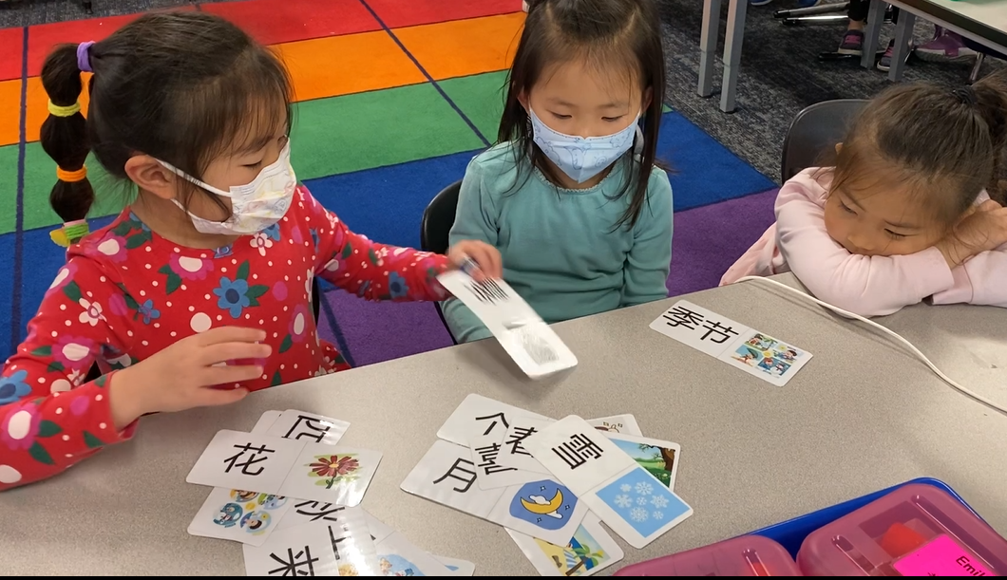
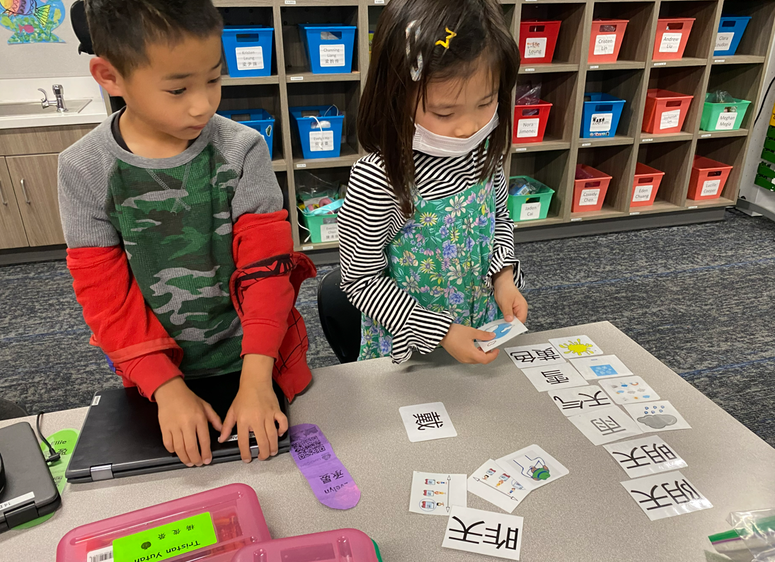
Small Groups Learning

Slide 21
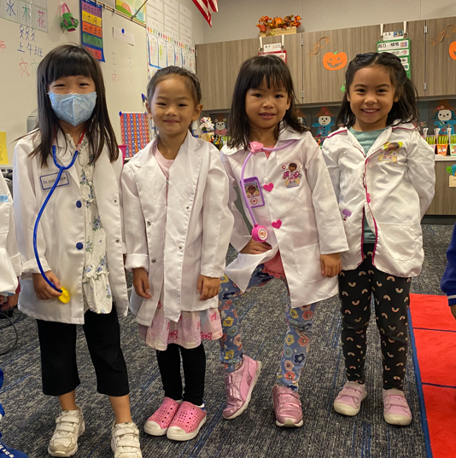
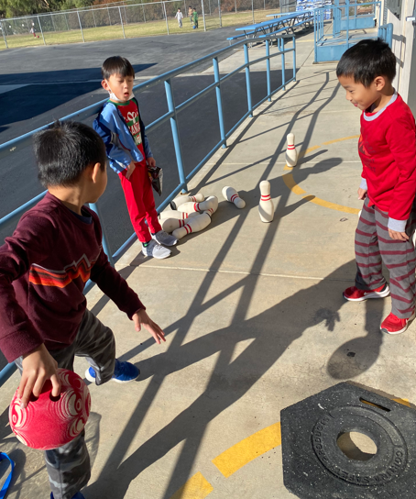
games

Slide 22
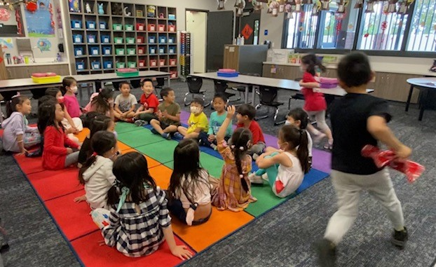
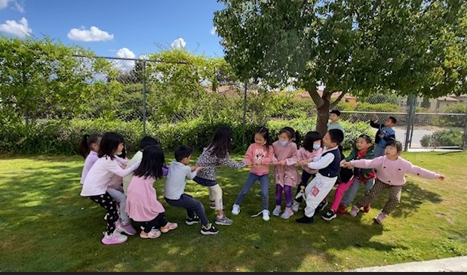
丢手绢、拔河

Slide 23
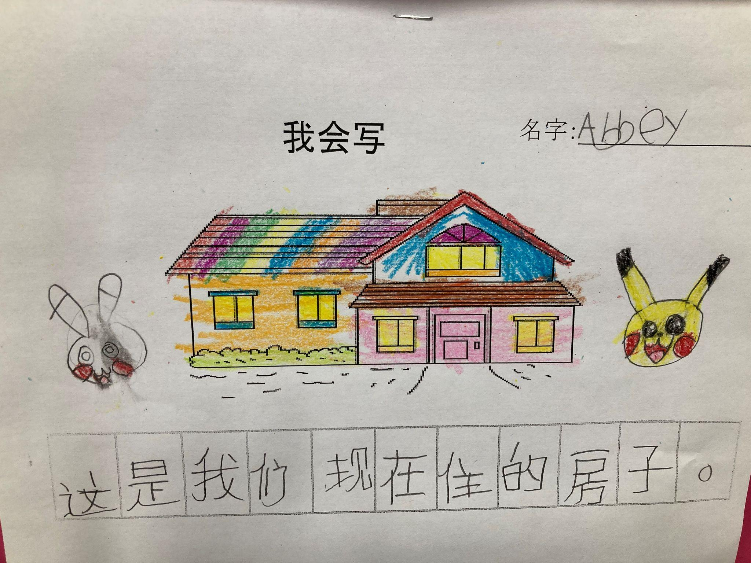
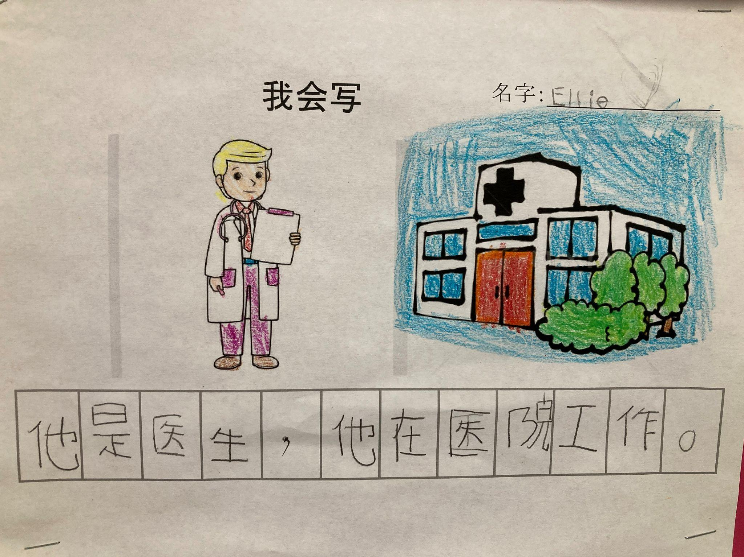
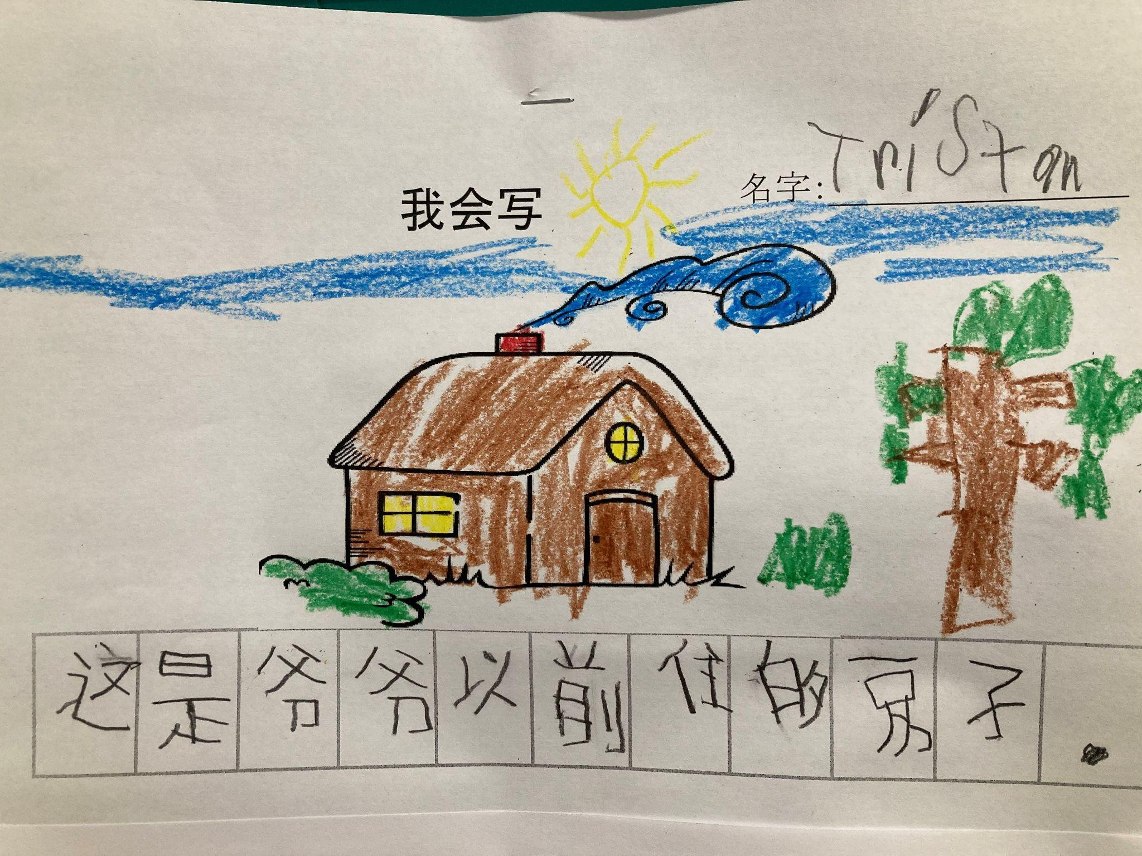
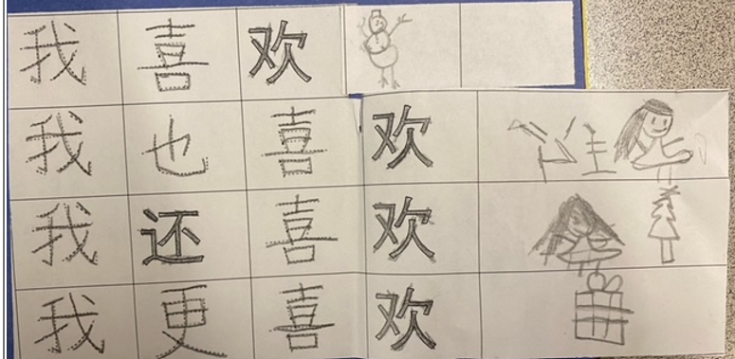
K sample writing in Chinese

Slide 24
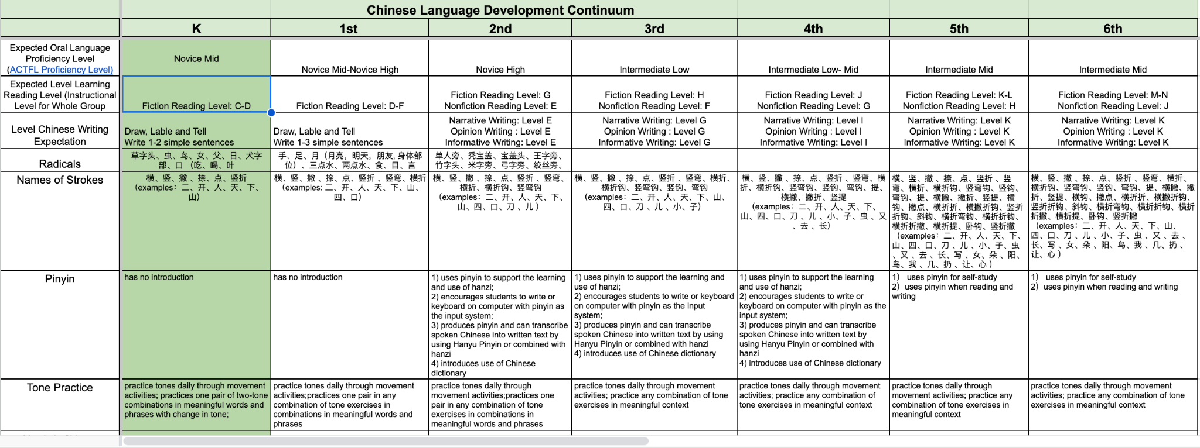
K-6th Grade Language & Literacy Continuum

Slide 25
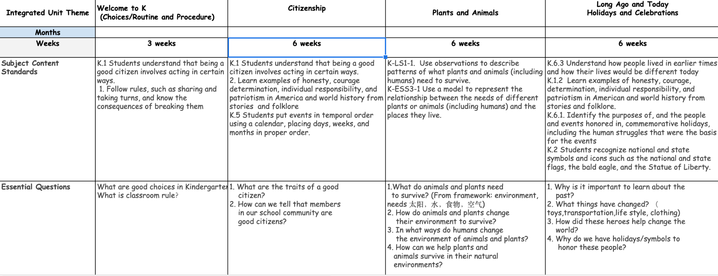
Examples of Integrated Units for Immersion Classrooms

Slide 26
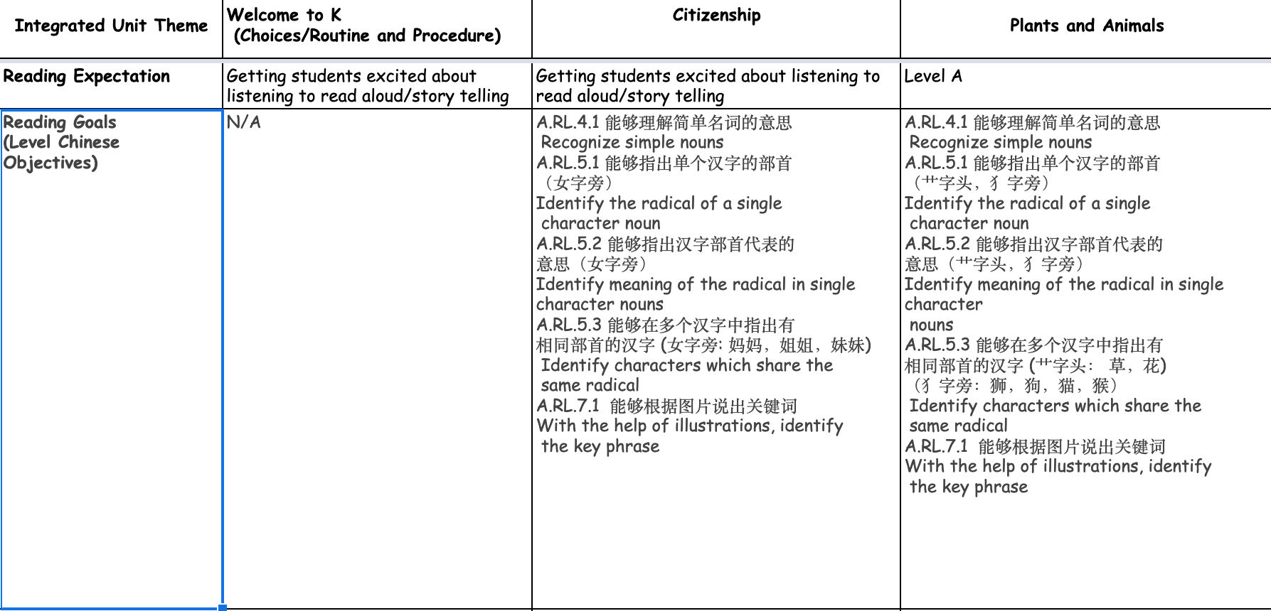
Examples of Integrated Units for Immersion Classrooms

Slide 27
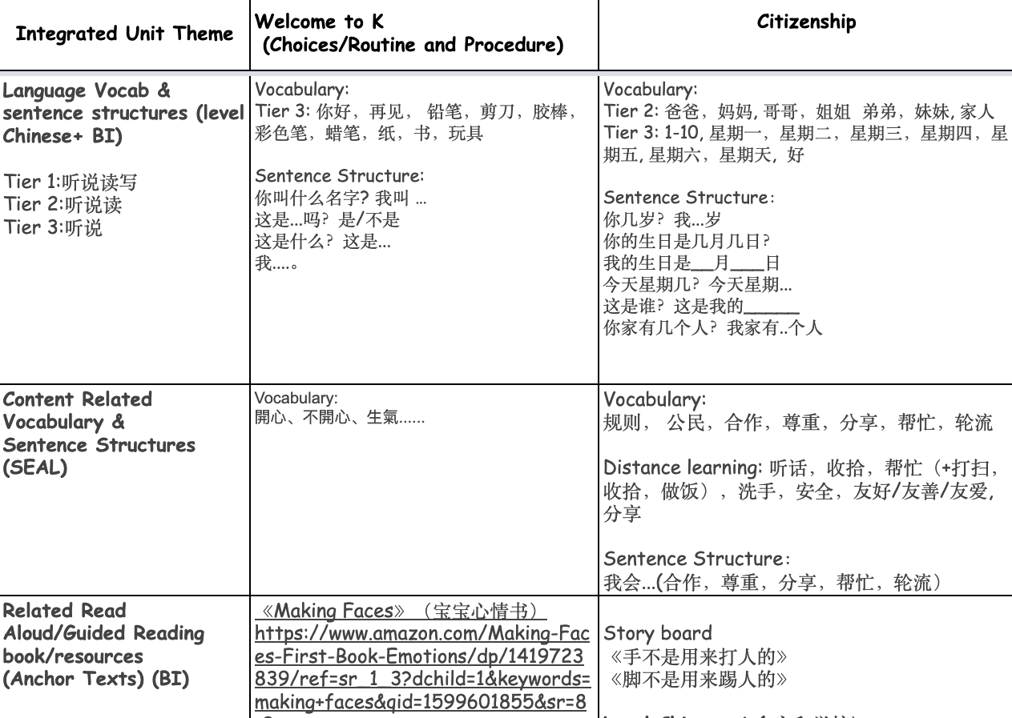
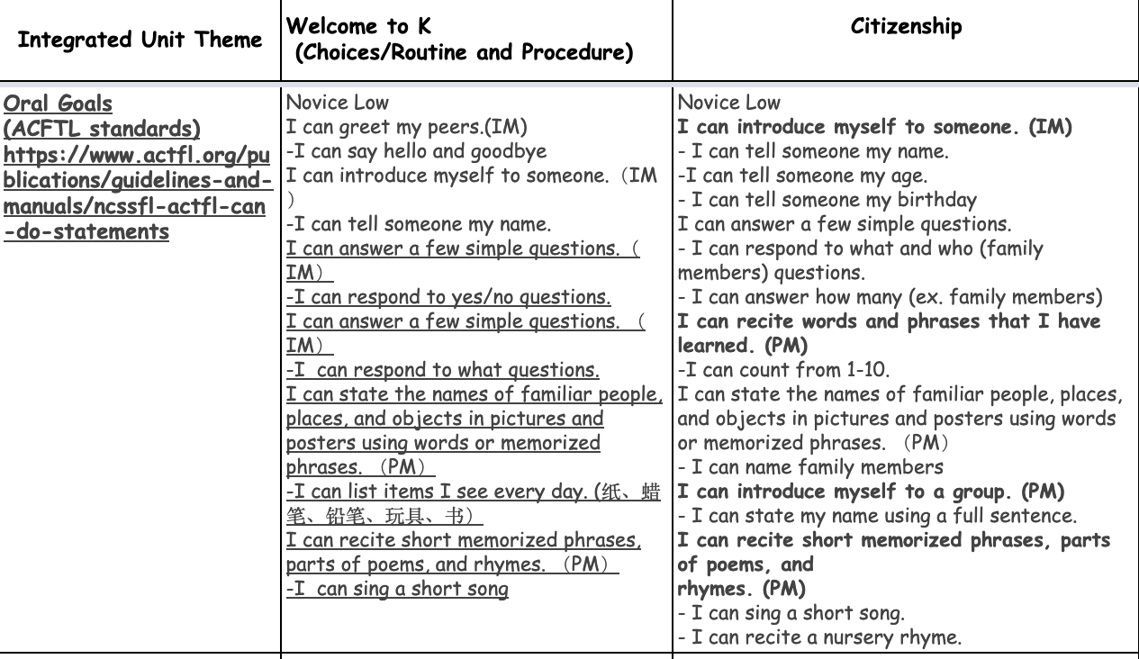
Examples of Integrated Units for Immersion Classrooms

Slide 28
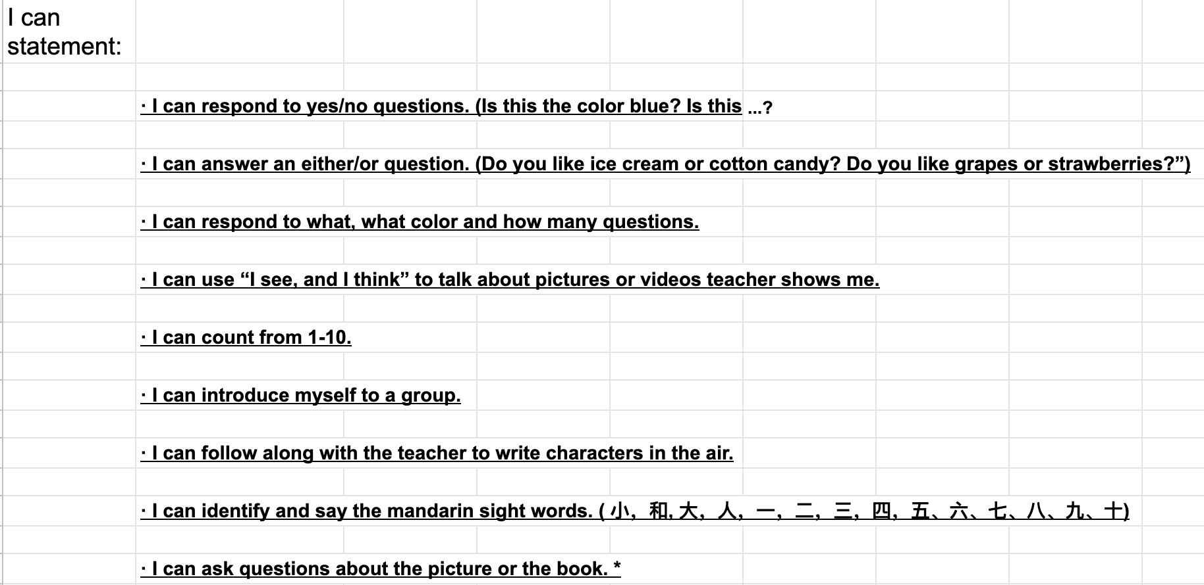
Sample Oral Assessment
Novice Low Level

Slide 29
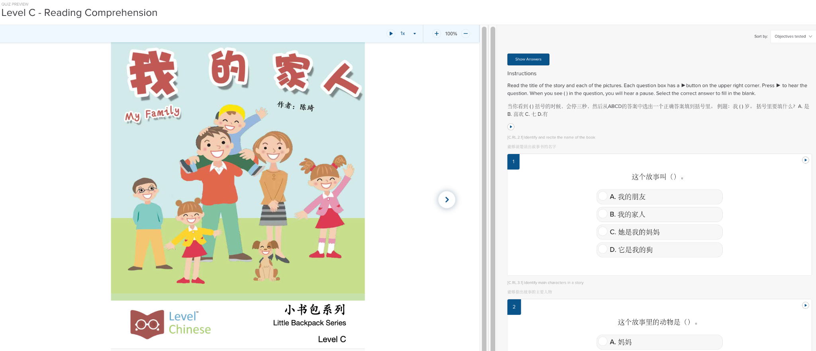
Level Learning Reading Assessment

Slide 30
Common Question from Family:
Will my child do well in English?
The research response to this question is longstanding and consistent. English proficient immersion students are capable of achieving as well as, and in most cases better than, non-immersion peers on standardized measures of reading and math.Research article from Center for Research on Language Acquisition
A temporary lag in specific English language skills such as spelling, capitalization, punctuation, word knowledge, and word discrimination can be evident in grades k-2. Within 2-3 years of instruction in English language arts, the lag most often disappears. There were no long-term negative repercussions to English language or literacy development for English proficient students.

Slide 31
Advice for Kindergarten Parents
Keep open communication with the teacher/school and parent community.
Try to balance your child’s extracurricular activities and Mandarin immersion learning. Learning subject matter in Mandarin is cognitively demanding.
Be patient……..Learning another language takes time.
Learn with your child at home. Your child will be delighted in being the teacher and will build a positive relationship and appreciation of the language and culture.
Notes:
Katherine

Slide 32
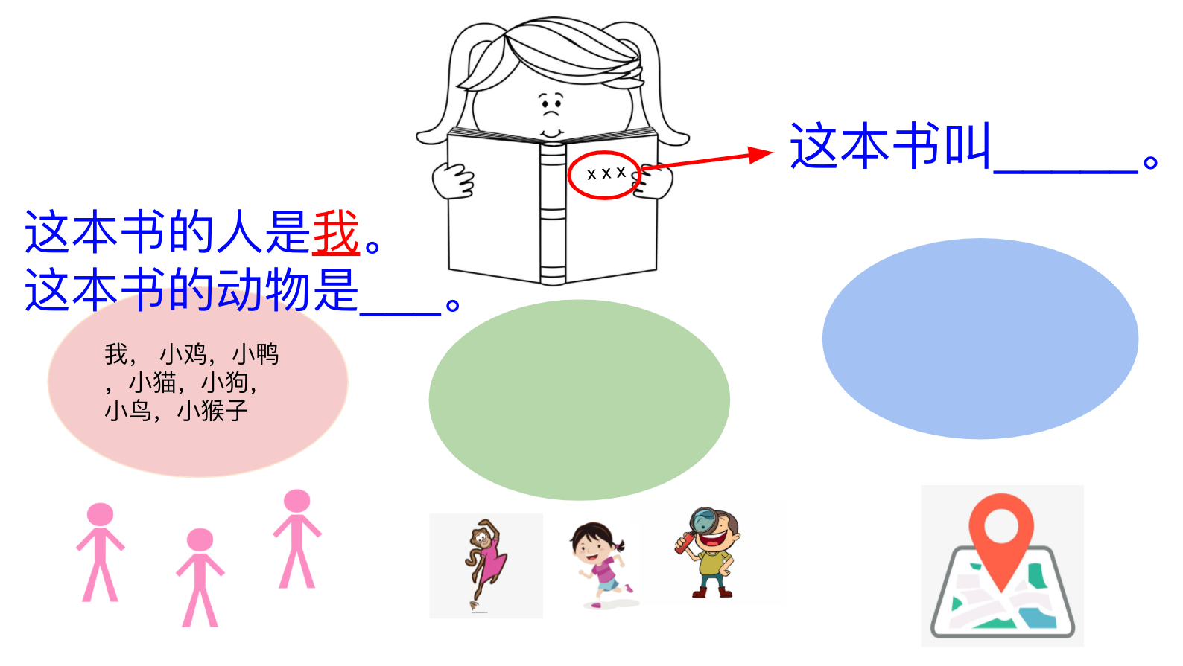
Ideas for Home Learning Support
Set up reading routine at home and have your child read to himself/herself daily/weekly
Choose favorite place and time to read (i.e. at picnic, in the park, in the public library etc.)
Have conversation with your child(ren) on the book they read may use your home language
Use graphic organizer/story map to ask your child(ren) some basic information they get from reading
Find a reading buddy for your child(ren)
Work with your child(ren)’s teachers on monitoring daily reading in both languages at home
Notes:
Winnie

Slide 33
Volunteers needed for cultural events- 春节

Slide 34
Volunteers needed for cultural events - 中秋节、圣诞节

Slide 35
Volunteers needed for cultural events - 元宵节、万圣节

Slide 36
Slideshow at the end of 2022-2023 academic year
https://drive.google.com/file/d/1LNmuH99gb2eAN2KaIr9U5IBod28rO-gA/view

Slide 37
Mandarin Immersion is a long term commitment and a beautiful gift you can give your child.
Resources for parents:
Mandarin Immersion Parents Council
Chalk Academy
Notes:
Katherine

Slide 38
谢谢
Xie Xie！
Q & A

